Slide 1
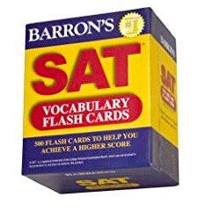
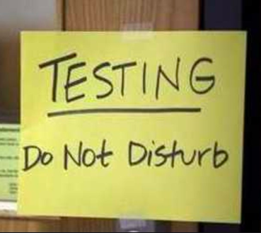
ACT or SAT ?
Notes:
A few months ago I was at a gettogether where I heard a bunch of moms talking about SAT and universities, and I felt left out.
In attempt to be a good mom , I went home and ordered a few books on SAT and flash cards. Started reading and with school got bit distracted. I have 2-3 years- he is just a fresh man.My son is a good kid and very independent assured me everything's is in control
So learning about SAT through this assignment is very pertinent and exiciting 1

Slide 2
Agenda
Problem statement : what test my son who is high school should take ? and how much score should he target for ?
ACT and SAT landscape : What,why,Who
ACT and SAT landscape with data.
What kind of questions can you answer with the dataset?
Analysis
Conclusions
Notes:
Before we dig in to the data set
-I’d like to to set the context around what these scores are and what they are not? why are these required?
- who might be interested in there scores
Potential college applicants
College board
universities
-I will summarize the data and what kind of questions to answer we can possibly answer with these.

Slide 3
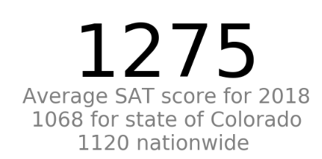
Notes:
ASK audience: I’d like to conduct thought experiment with you all, I am sure all of you know the SAT score ranges 400 -1600. So if I were to tell you that this is someone’s SAT score , what do you think this number mean?
impression about the student?
What does this tell you about other high school students is USA ?
What insights you see based on you experience as test taker , perhaps an on admission comity or just a from experience - around predicting success
Record answers:
Scott;
Magnus
John
Noelle
* it does give a benchmark for comparing yourself against other students with some quantified number.
No sure if its a good bench mark
Dont know what goes in calculation
-Any time someone consider using average like that, to compare like I think they
There was a statistician that drowned crossing a river... It was 3 feet deep on average
ACT is similar to SAT and we could conduct same experiment with a ACT scores.
I asked bunch of people if one was better than other but it seemed have preference
My state State required SAT / act -
People took sat didn’t know about act and vice versa
Some people didn’t take Test at all and are doing great !

Slide 4
What is ACT and SAT ?
Standardized tests -
Why SATs and ACTs?
measure “college readiness” by admission committee
measure scores only in relation to others test takers.
Measure performance against predetermined criteria
Invented in 1920s to be a meritocratic movement ,
Why not use school grades - they quantity ‘learning’?
normalize to a common scale
Independent measurement - Prevents schools can inflate GPAs
Provides some benchmark when we look at large volumes of these data
Notes:
What the heck is SAT test and why do we need this test?:
Simply put they are ‘standardized test’.
I am sure you all are familiar with the standardised test.
1st standardized test that we know of was administered - in china 2000 years ago. Official used to measure aptitude for various government post - the subject matter included philosophy , farming and even military tactics.
Thes test continued to be used around world for 2 millenia
SAT and ACT are specifically designed to measure ‘college readiness’ for an applicant by <1>, <2> or both. You need to do well to increase your chances to get in to your dream school!
School of thought was , some children are born with privilege and others are not , so we need one way to measure all of them - so people can get scholarship based on merit. College board a non-profit organization that owns it, their mission is to connect students with universities.

Slide 5
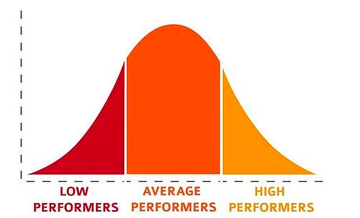
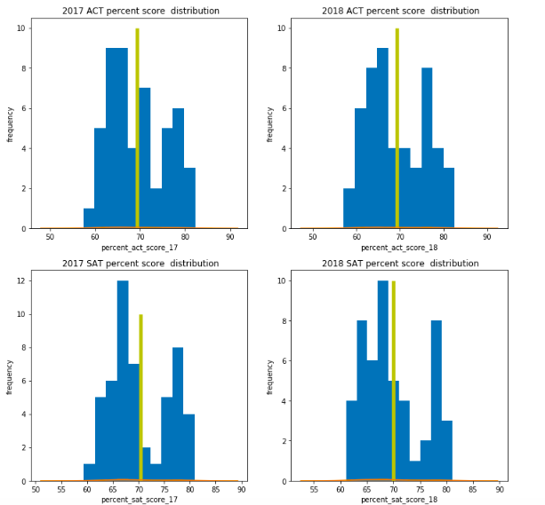
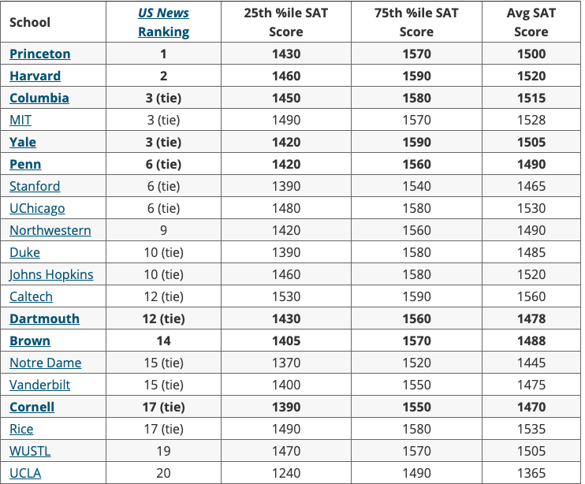
Measure College readiness?
Notes:
Now that we know generally what SAT score is , let’s examine the score again -
1275*100/ 1600 = 80% score on the test , is that a good score? - it might be
worthy enough to be place in top 20 schools.
* 75 percent of the students who go to these schools. Have score 1400
* lowe 20 percentile
Should this ‘ test taker ‘ be admitted to the school ?
even if if he gets accepted - Having a b+ or c grade on ongoing basis might be detrimental than A+ and being star in a different university.
On other hand , he might get opportunity that he never had and surprise the world
Clearly, a lot of emphasis is given to the score.
Not true measure of college ready ness for a student :
Bell chart -Learn little about alot of ppl in short time , can’t tell alot about single person.
There are other factors that go in to being college ready or there might be reasons why you didn’t test well
Even if its a good measure to measure your “certain skills” it is not used in the right way:
Predictor -“ intellect/success”
To graduate successfully and be awesome scientist you need “ python skills’, we are given a test periodically - there are around 50 + students-
all do poorly and bob is in 75 percentile?
Only bob poorly but rest of the class does well which puts in 25 percentiles?
I wanted explore , geography

Slide 6

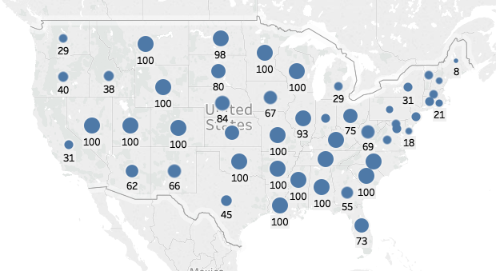


SAT and ACT participation by geography
SAT participation in 2017
ACT participation in 2017
SAT participation in 2018
ACT participation in 2018
Notes:
Most people just take tests based on geography and what state required or what what was prevalent.
2017 participation
* SAT is more popular in east course while ACT popularity is more dominant in mid west region.
ACT is more widely accepted than SAT
2018 has continues same trend - but there are few states that
Colorado, idaho - sat participation sky socketed from 2017 to 2018
So I decided to dig further into it

Slide 7
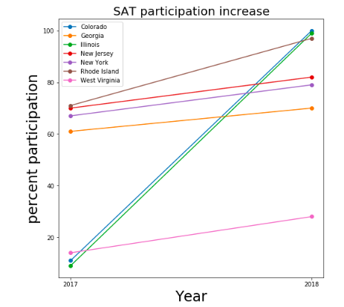
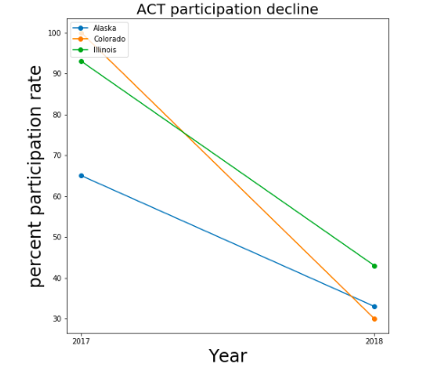
Whats up with increased SAT participation in co?
Notes:
This chart of the left is a slope chart - Year on X axis , Sat participation percent on Y axis
Ita showing all the states that has , 10% of higher sat participation in 2018 than 2017.
Not only colorado shows up in the chart it shows a pretty big jump from 11 percent to 100%.
So , I decided to do the same for ACT , to really understand if students were taking both SAT and ACT , just one.So I plotted another slope chart this one is similar to the left chart but it comparing the change is ACT participation from year 2017 to 2018 for states where we see a change higher than 10 % or higher.
We can see there is sharp decline in ACT participation which might be co-related to increase in SAT participation.
That lead me to ask another question - what was driving this 100 % adoption in SAT
*

Slide 8
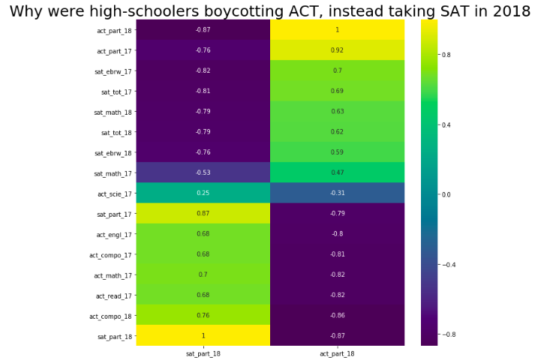
What's driving 100 % adoption in Colorado?
Notes:
So , I decide to dig further and plotted everything we had in dataset to determine if there was a strong co-relation between one of the parameters in data to the’ participation’.
I have particilation rate on x axis for 17 and 18 and all other parameters in the dataset on Y axis.
ACT - science, math , reading ,writing
SAT - ebrw reading writing ,math
I had two finding from this chart
Strong co-relation between ACT participation and SAT participation. One went up and other went down. But one didn’t seem cause of other .that's what we are investigating
The other odd thing that notice stron negative co-relation between the individual subject scores and total score and participation - Higher participation meant lower average score.

Slide 9
SAT revamp - driving SAT participation
The College Board , owner
The old SAT had not kept up and was really outdated
Revamped in 2006 - to be more aligned with the current curriculum and what students learnt in high school.
The College Board has partnered with online education provider Khan Academy® to provide free online SAT practice to all students.
Lastly , partnership with schools around country so that students can take the test free.
Notes:
Website for colorado department for eductaion has rationale
https://www.cde.state.co.us/assessment/coloradosat

Slide 10
Higher participation drives the average score down
Test takers - watch out - before you use that to gauge, how hard should you work to stand out?
,
Notes:
https://www.washingtonpost.com/local/education/sat-scores-drop-for-2019-class-but-participation-rises-through-testing-in-schools/2019/09/23/332fc4d0-de11-11e9-8dc8-498eabc129a0_story.html

Slide 11
Conclusion
Yes , My son should
Take a SAT , as its mandatory
He needs to work hard - can not use the argument
“Mom I am way above average mom , i don’t need to study ‘
Target score - there was not much in data but it would be interesting to see which universities pay how much emphasis on scores !

Slide 12

Ruler can not measure circumference of orange!
Designed to measure certain skill set but by no mean measure of intellect - “ not be all “
Is this score really predictive of college success ?
Age and no of attempts have any impact and score
Can we improve the score to quantify some of the other parameters like grit, collaboration,passion ,
How braveness firefighter might be show
or how diplomat will handle tough situation.
to measure if are really measuring success of our children without making them feel unworthy!
Can’t blame the tests. *Use them as true “college readiness threshold” mean.
Notes:
students took the test last spring in the state’s public schools. The SAT has a much a lower profile in Colorado

Slide 13
References
https://blog.collegevine.com/here-are-the-average-sat-scores-by-state/
https://www.denverpost.com/2017/03/06/colorado-juniors-sat-college-exam/
https://www.washingtonpost.com/local/education/sat-scores-drop-for-2019-class-but-participation-rises-through-testing-in-schools/2019/09/23/332fc4d0-de11-11e9-8dc8-498eabc129a0_story.html
https://www.youtube.com/watch?v=YtE0OsRWeYI

